Slide 1







VLSI System Design CSA & VLSI Lab.
Prof. Kim jin-sang

Slide 2



Functional Simulation
Use Cygwin or Xmanager …etc (SSH1 or 2 available Tools)
●
●
Login to Worksation ID / PW
: 163.180.118.55
: Your student number/vlsi
✓

Slide 3
Contents
Front-end design
Back-end design

Slide 4
Design Compiler

Slide 5
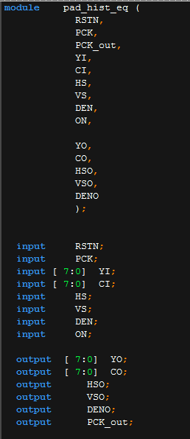
Preparations before Front-end design
you need to make top module .
ex) your top module : hist_eq.v
after changing your top module: pad_hist_eq.v
declare input, output
2) you need to make wire that connect top module and core module.
ex) input RSTN;
input CLK;
output OUT;
wire RSTN_p;
wire CLK_p;
wire OUT_p;

Slide 6
PAD
RSTN
RSTN_p
hist_eq
CLK
PAD
CLK_p
OUT_p
PAD
OUT
wiring core and pad

Slide 7
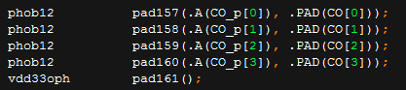
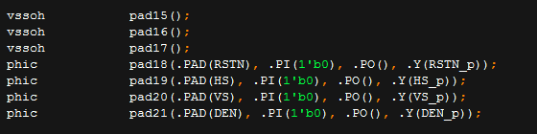
Samsung 130nm chip size : 4mm*4mm , the number of pad : 208
#kind of Pad
Input pad (phic)
Output pad (phob12)
Power pad (vdd33oph , vdd12ih)
Ground pad (vssoh, vssiph)
you need to move your Verilog code from windows to linux using ALDrive and FTP

Slide 8
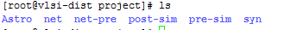
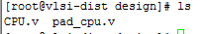
#You need to make some directorys in project directory : Astro, syn, pre-sim, post-sim, net, net-pre
#And then, you need to move 2 files , basic_syns_design.tcl , synopsys_dc_sam013.setup.tcl to syn directory.
#And , you need to make DIRs : db, design, log
#you need to move your Verilog files to design directory.

Slide 9
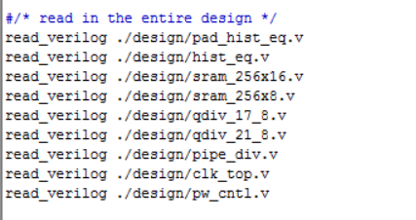
And, Open your files : synopsys_dc_sam013.setup.tcl , basic_syns_design.tcl
ex> vi <file>
and then, you can see “setenv SEC_SYNOPSYS”, “setenv SEC_SYNOPSYS_AUX” .
so, you need to fix the path to your path.
Fix it to your files.

Slide 10
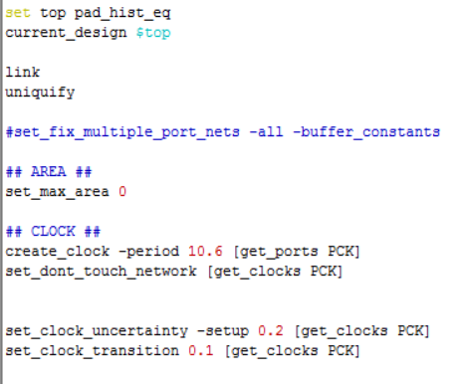
in basic_syns_design.tcl
PCK -> your Clock name
10.6 -> your Clock period
set_max_area -> 0

Slide 11
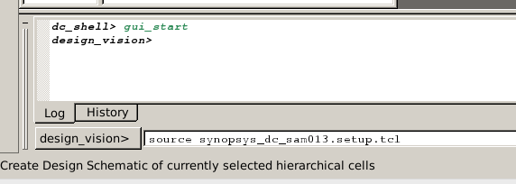
in syn directory
type “dv”
so, Design Compiler’s operation
and then, first of all , type “source synopsys~.tcl “, second “source basic ~.tcl”
and then, if there are some errors, you need to fix something such as your code, path etc..

Slide 12
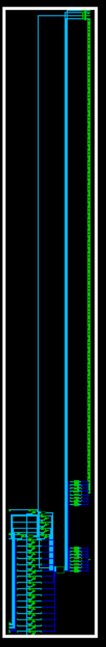
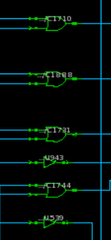
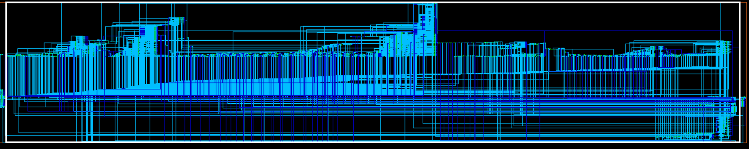
if there is no errors, you can see your synthesis circuit.
Front-end design end !!!

Slide 13
Pre-sim
after synthesis, you can see .ddc, .sdc, .sdf, .v files in db DIR.
you need to copy .v, .sdf files to net-pre DIR.
!!!! before Pre-sim, you need Testbench code in net-pre DIR.

Slide 14
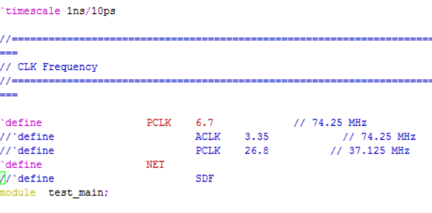
Pre-sim
you need to declare that script at top of testbench code.
`timescale declare
`define CLK : if you need it, you can declare. its up to you.
`define NET : you have to do it. this is to create dump file.
`define SDF : usually, you don’t need to declare SDF for Pre-sim, but you need to
declare SDF for post-sim.

Slide 15
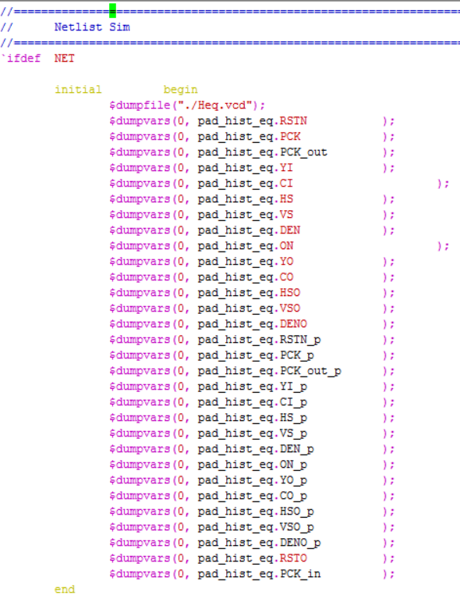
Pre-sim
as follows, you need to declare it at bottom of your testbench code.

Slide 16
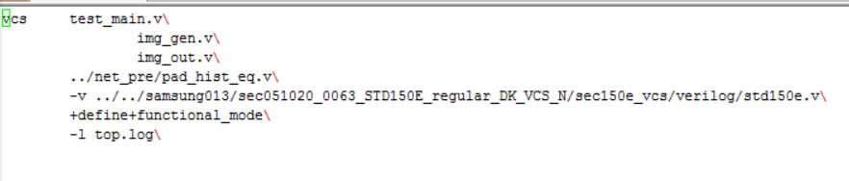
Pre-sim
vcs testbench.v
netlist.v
next “-v”, with what looks on, you equally need to write it .
if you do this, you can operate testbench.
if you can see “ ../simv up to date” , Success!!!
And then , you have to type “./simv”

Slide 17
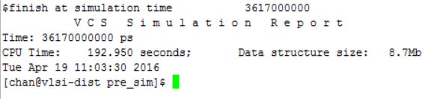
Pre-sim
if you can see this, Success!!
and then , you need to type “dve”
file -> open database -> .vcd file -> open $ simulation wave check!
End!!

Slide 18

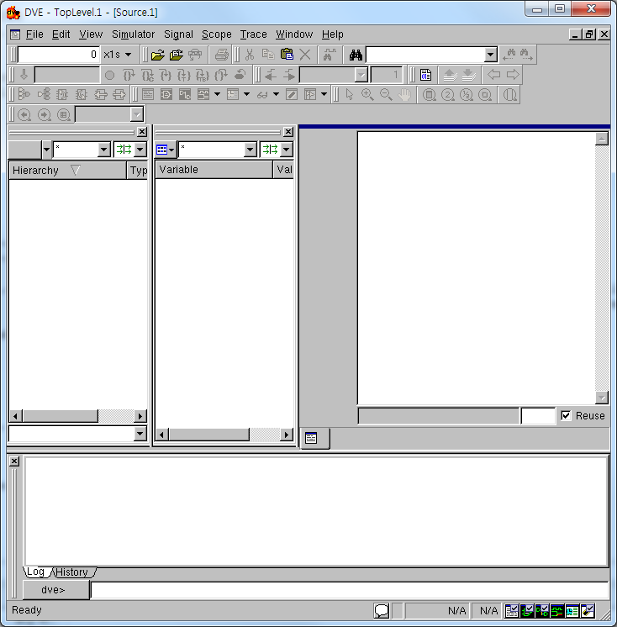
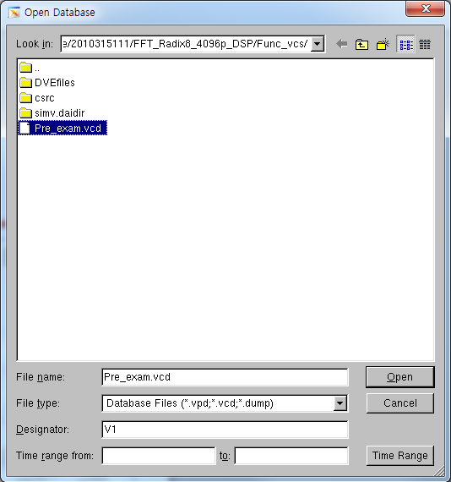
DVE
File->Open Database
Choose “Pre_exam.vcd”
CSA & VLSI Lab.
7

Slide 19
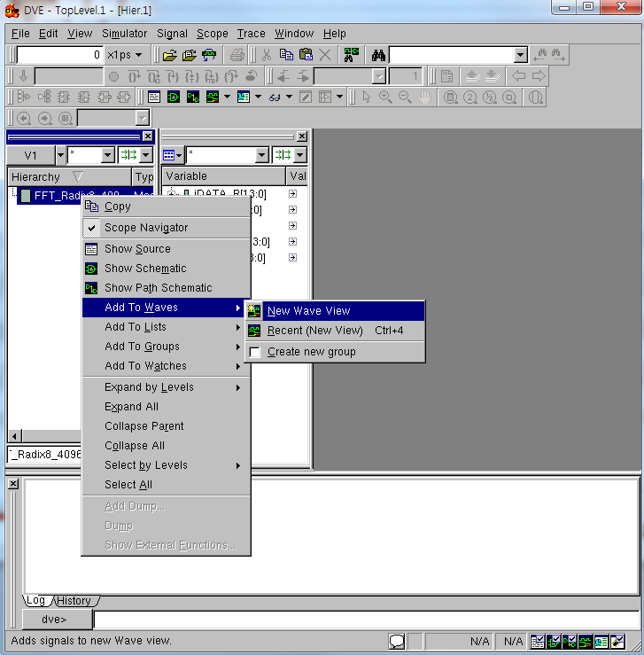
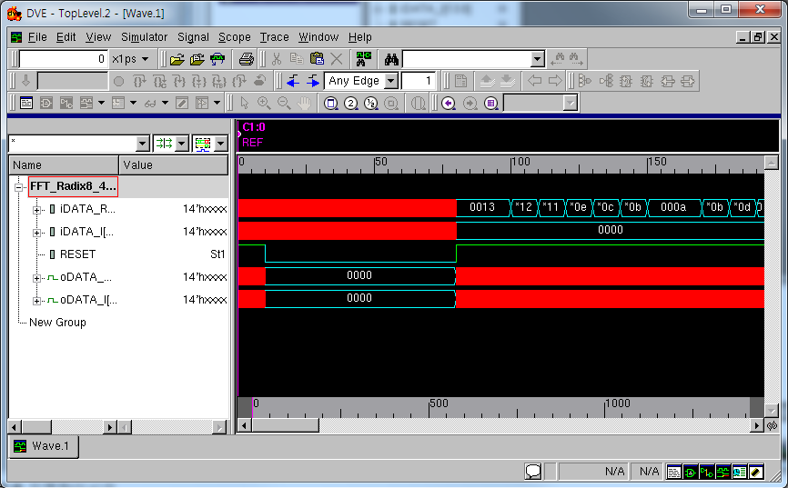
Right Click
DVE
Choose Add to Waves
-> New Wave View
Useful Blind Key
“ f, +, - “
8 CSA & VLSI Lab.

Slide 20

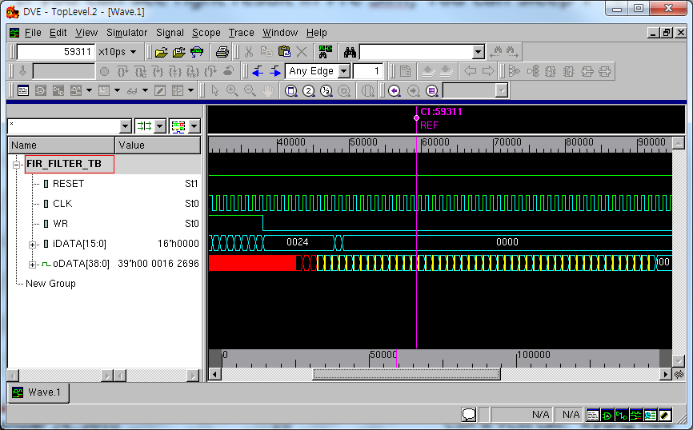
Pre Simulation Result
This is right result of Pre Sim(We can check some delay and glitch) But result must be same with Functional simulation.
You’ve just finished core synthesis!
ber 29, 2013 19 CSA & VLSI Lab.
Octo

Slide 21



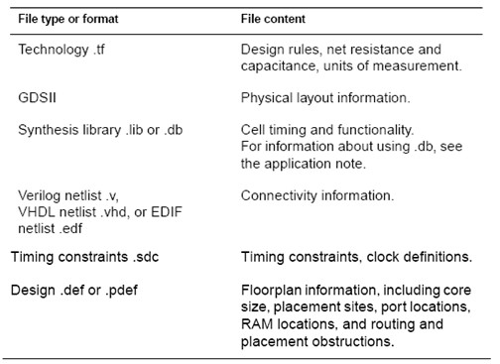
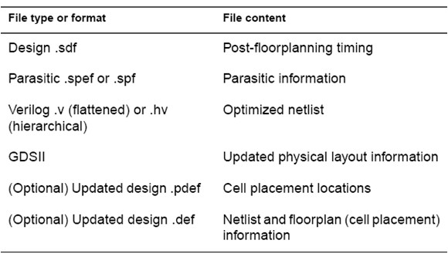
Astro Input and Output
Astro Output Files
Astro Input Files

Slide 22

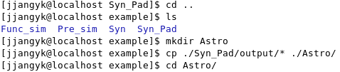
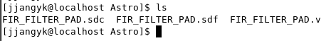
Preparing P&R
Now We get Finally 3 file : ./example/Syn_pad/output/
FIR_FILTER_PAD.v FIR_FILTER_PAD.sdc FIR_FILTER_PAD.sdf
(Core netlist with pad) (Constraints)
(Cell Delay information)
Make a new DIR “Astro” in Design root DIR Copy All results to Astro DIR

Slide 23




Common Informations for P&R Process
We use SS 0.13um Standard Cell Library
Library DIR :
/home/VLSI_graduated_2016/<your id>/samsung013/Astro_PHA_lib
TECH files(.tdf, .tf, .clf)
./Library DIR/TECH/
PAD
/home/VLSI_graduated_2016/<your id>/samsung013/Astro_PHA_lib/std150e_60poi_io_6lm_071011

Slide 24


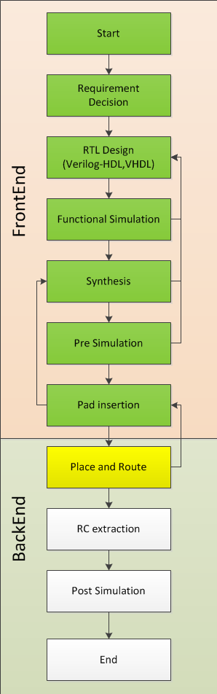
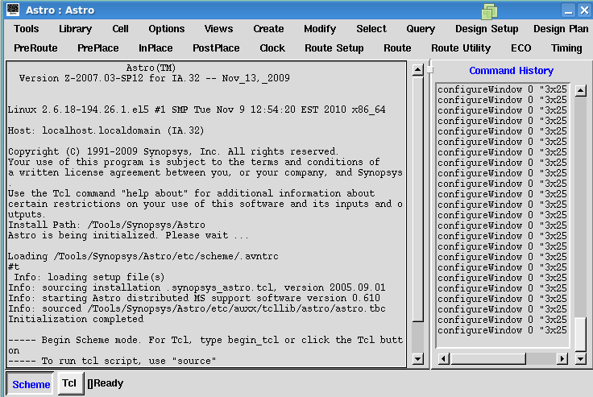
Run Astro
ab.
Move to ./Design DIR/Astro DIR
Type “Astro -galaxy”
October 29, 2013 27 CSA & VLSI
L

Slide 25

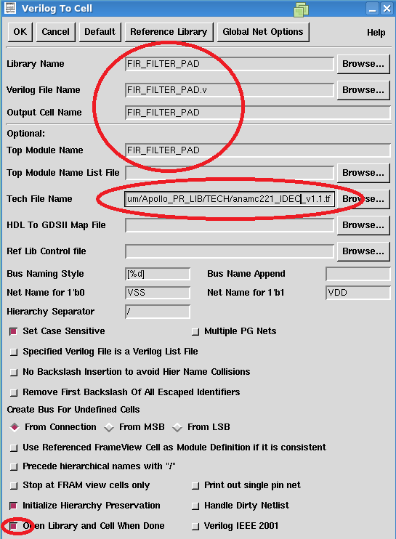
Load Synthesis Result
CSA & VLSI Lab.
Tools > Data Prep
Netlist In > Verilog To CEL
Fill the Blank like Picture
TECH file :
/home/VLSI_graduated_2016/<your id>/samsung013/Astro_PHA_lib/TECH/std150e_prim_6m.techgen.tf
28

Slide 26

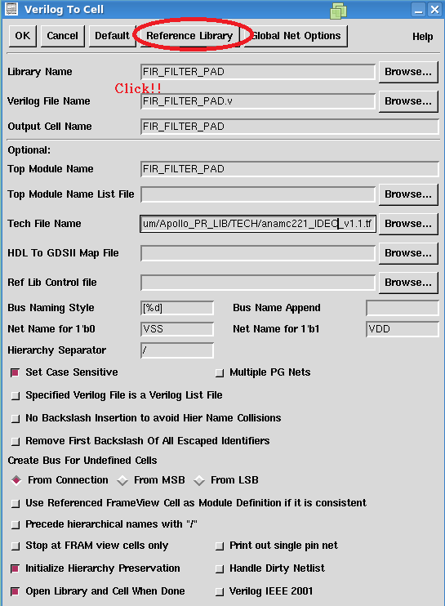
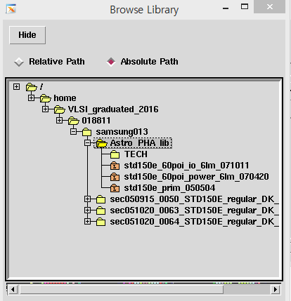
Library Setting
Add Two Library
Use Absolute Path
And then Hide
29

Slide 27

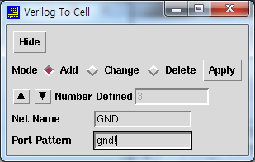
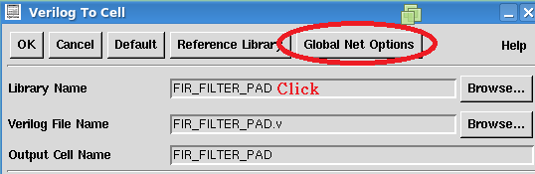
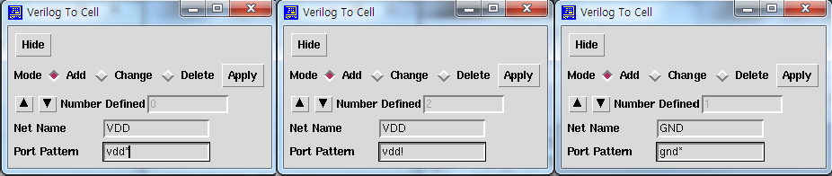
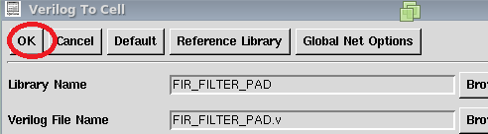
Global Net Setting
Remember …. We use VDD, GND
And then Click OK~
CSA & VLSI Lab.
30

Slide 28

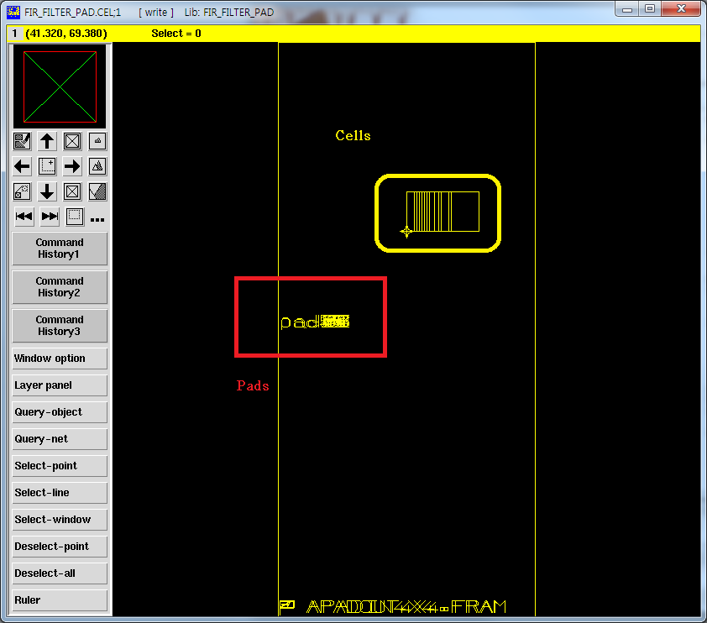
Loaded Design
●
Check the Cells & Pads

Slide 29

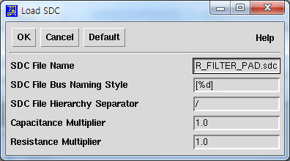
SDC(constraints) Load
.sdc file modification Before Loaded set_ideal_network [get_ports CLK]
-> set_propagated_clock [get_clocks CLK]
Tools > Astro
Timing > Load SDC File
Name is “FIR_FILTER_PAD.sdc”
<=We get this file after synthesis

Slide 30

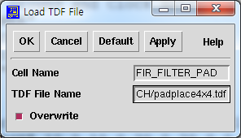
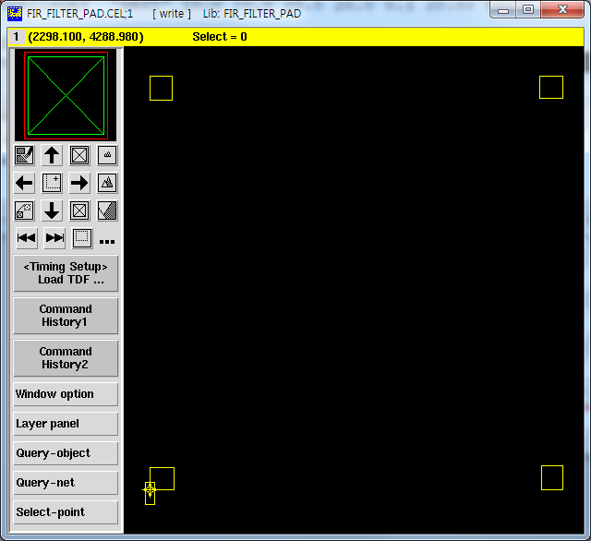
Load TDF file
We will use 4mm x 4mm die size 120pin package
TDF File has Pads location information of chip
Timing Setup > Load TDF File
●
TDF file location :
/home/VLSI_graduated_2016/018811/samsung013/Astro_PHA_lib/TECH/~~~.tdf
●
●
Push ‘F’ key in Cell view window
You will see this picture

Slide 31

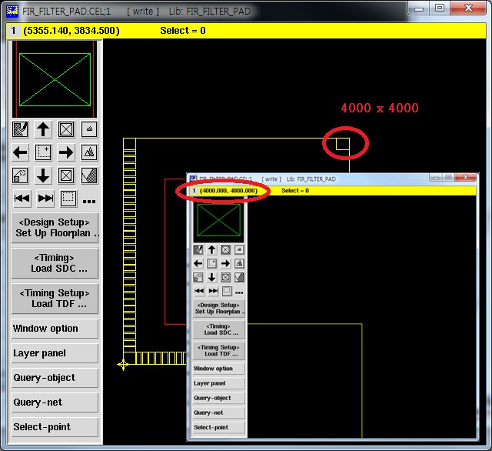
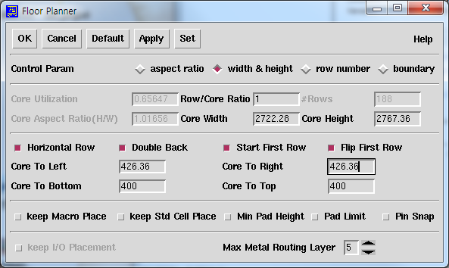
Floor Planning
I Recommend that the value of Core Utilization is nearly 0.65(35% for routing or margin) Adjust core width & Height & Margin -> top right coordinates must be (4000.00,4000.00)
Useful blind key z(zoom), f(focus) , Drag(position to zoom)
Then click OK button.
October 29, 2013
34 CSA & VLSI Lab.

Slide 32
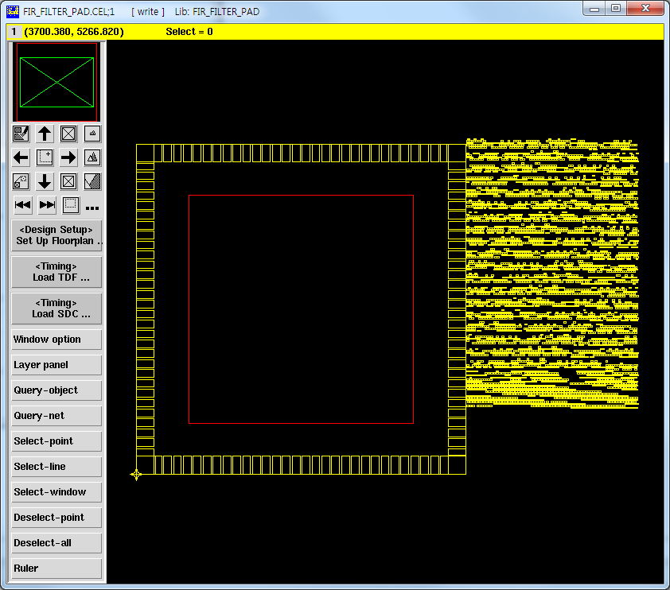
Floor Planning
Red Box = Core Area

Slide 33

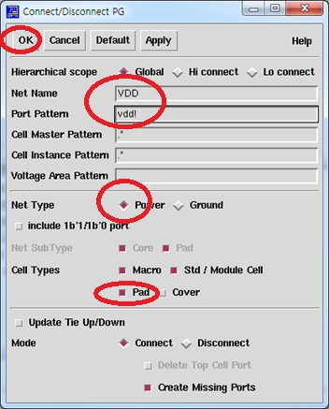
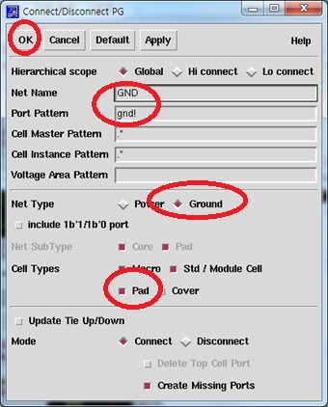
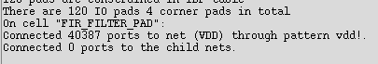
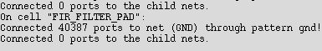
Connect Ports to Power/Ground
PreRoute > Connect Ports to P/G

Slide 34

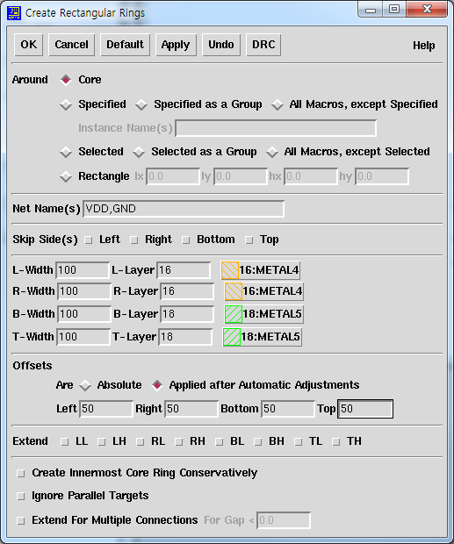
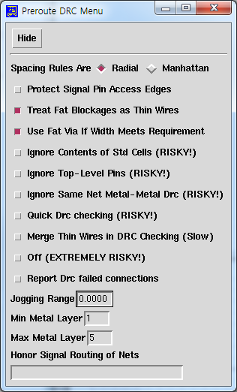
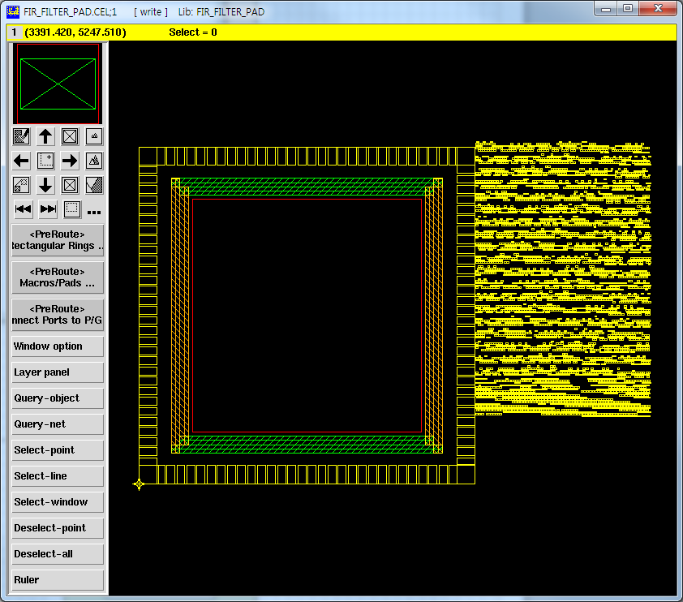
Create Rectangular Rings
PreRoute > Create Rectangular Rings
37 C
SA & VLSI Lab.

Slide 35

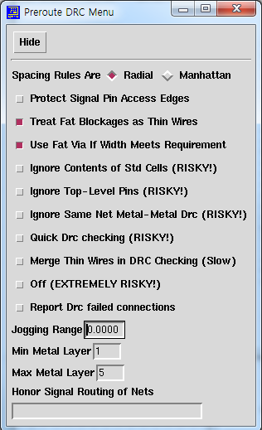
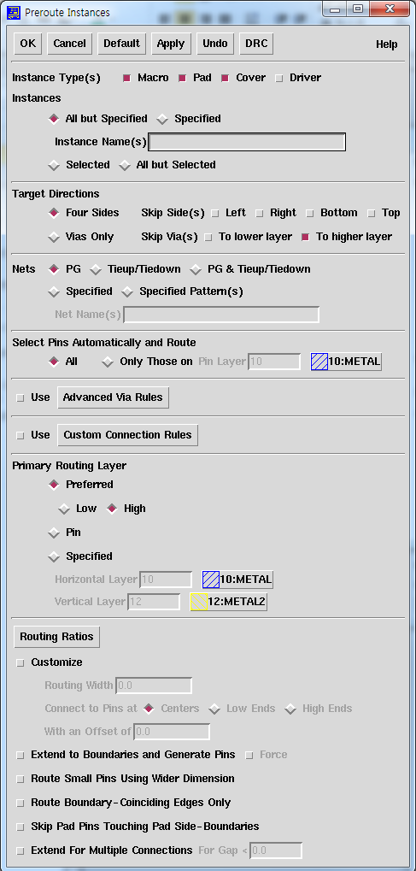
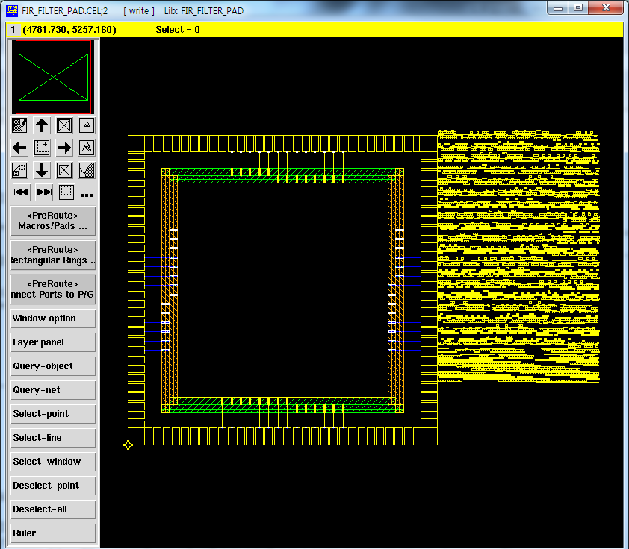
Macros/Pads
PreRoute > Macros/Pads
October 29, 2013
38
CSA & VLSI Lab.

Slide 36



Design Placement
InPlace> Design Placement
39 CSA & VLSI Lab.

Slide 37





Standard Cells
PreRoute > Standard Cells
October 29, 2013
40
CSA & VLSI Lab.

Slide 38





Global Route / Detail Route
Route > Global Route
Route > Global
Route
October 29, 2013 41
CSA & VLSI Lab.

Slide 39



Route Finished
ab.
October 29, 2013
42
CSA & VLSI L

